Slide 1
Hyperdimensional Computing /
Vector Symbolic Architectures
Slides adapted from: https://www.youtube.com/watch?v=zUCoxhExe0o

Slide 2
Agenda
Motivation
Basics
Example(s)
Takeaways

Slide 3
Motivation - Brain side
Brains are complex
Sensory signals are variable & noisy
Neurons malfunction and die
Brain is flexible
Would be cool to model them
Clues:
40 billion neurons
240 trillion synapses
6000 connections per neuron on average

Slide 4
Motivation - Requirements
Needs a theory of computing, without it it’s nearly impossible to reverse-engineer
Requirements:
Speed of learning
Retention over a lifetime
Generalisation from examples
Reasoning by analogy
Tolerance for variability and noise in the data.

Slide 5
Motivation : Key Observation
Distant concepts are connected by short links:
Man ≈ Lake
Man ≈ Fisherman ≈ Fish ≈ Lake
Man ≈ Plumber ≈ Water ≈ Lake

Slide 6
History of computing with high dimensional vectors
1950s - Von Neumann: The Computer and the Brain
1960s - Rosenblatt: Perceptron
1970s and ‘80s: ANNs / Connectionism
1990s - Plate: Holographic Reduced Representation
Why now:
Technology is ripe
We need to supply the compatible theory of computing

Slide 7
Basics
Hyper = High dimensional

Slide 8

Basics
Hyper = High dimensional

Slide 9
Basics
Hyper = High dimensional (10.000+ )

Slide 10
Basics
Hyper = High dimensional (10.000+ )
Randomness is important

Slide 11
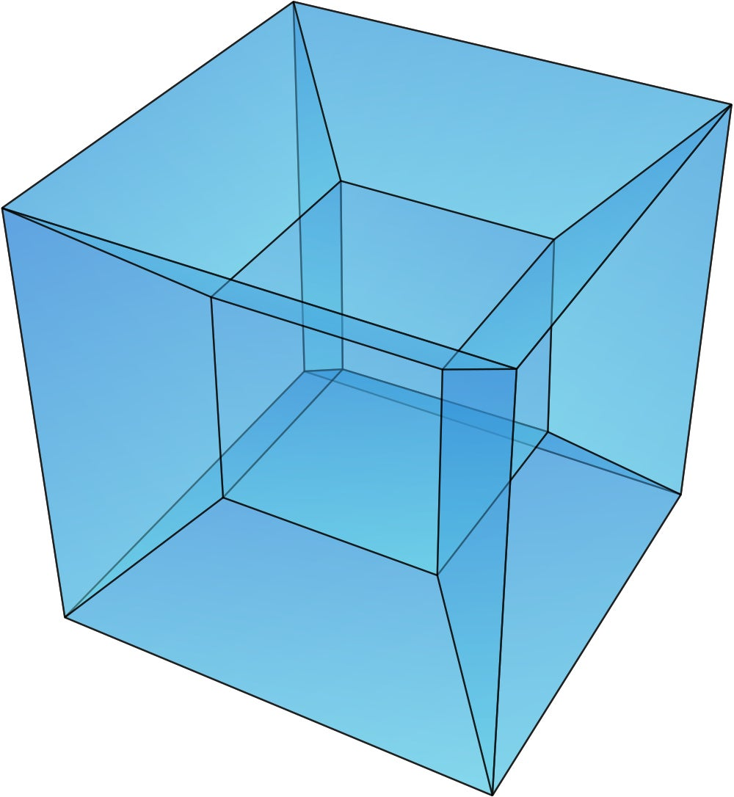
Interesting properties of Hyperdimensional Vectors
Can be imagined as a 10.000 hypercube

Slide 12
Interesting properties of Hyperdimensional Vectors
Can be imagined as a 10.000 hypercube
Has 10.000 mutually orthogonal vectors, but billions of nearly orthogonal vectors
Retrieval works based on similarity
“Noise” means dissimilar/orthogonal to any known vector (similarity ~0.5)

Slide 13
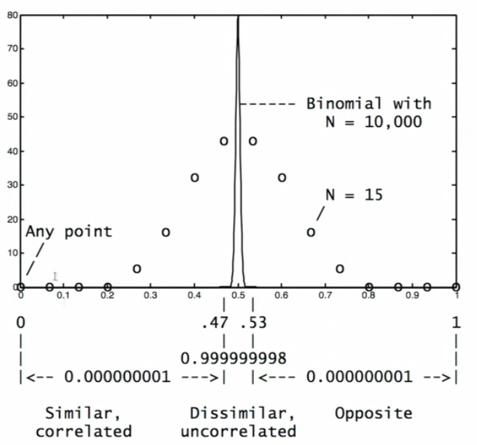
Interesting properties of Hyperdimensional Vectors
Can be imagined as a 10.000 hypercube
Has 10.000 mutually orthogonal vectors, but billions of nearly orthogonal vectors
Retrieval works based on similarity
“Noise” means dissimilar/orthogonal to any known vector (similarity ~0.5)
99.999997% lie in 0.5 ± 0.03
2 in a billion lie outside

Slide 14
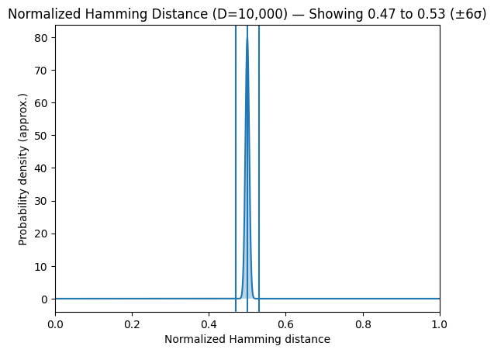
Interesting properties of Hyperdimensional Vectors
Can be imagined as a 10.000 hypercube
Has 10.000 mutually orthogonal vectors, but billions of nearly orthogonal vectors
Retrieval works based on similarity
“Noise” means dissimilar/orthogonal to any known vector (similarity ~0.5)
99.999997% lie in 0.5 ± 0.03
2 in a billion lie outside

Slide 15
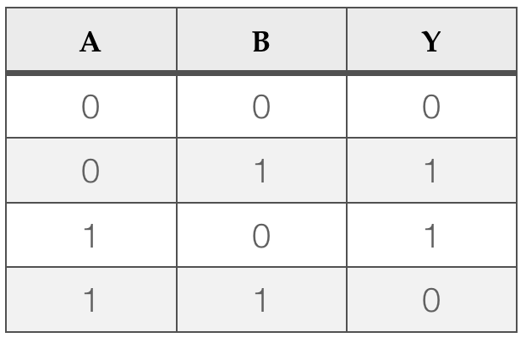
Arithmetic
“ADD” → Coordinatewise majority
Also called ‘Boundling’
Produces similar vectors similar to both (superposition)
”MULTIPLY” → Coordinatewise XOR: M = A*B
Also called ‘Binding’
Produces dissimilar (≈orthogonal) vectors
Tells if the bits are different
XOR is it’s own inverse (A * A = 0)
Distributes over addition
“PERMUTE” → rotate/shuffle vector coordinates P = rA
Preserves distance
Matrix form (not binary)
Used to encode sequences
Hamming distance or cosine for similarity
Resulting vectors have the same dimension

Slide 16
Arithmetic - Key takeaways
Randomly chosen vectors are almost orthogonal
Addition produces similar vectors (take the majority)
Multiplication produces dissimilar vectors
Multiplication is invertible and distributes
Permutation is also invertible and distributes
Multiplication and permutation preserve similarity

Slide 17
Switching between binary to bipolar
Binary 0 ← → Bipolar 1
Binary 1 ← → Bipolar -1
XOR ← → Multiply
Majority ← → Sign

Slide 18
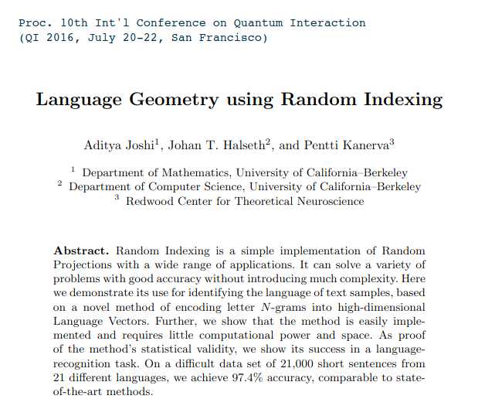
Example(s)
Paper:
Context vector
Rule learning
Analogy
Lecture:
Language example

Slide 19
Example - Motivation
People can identify languages without knowing the language
METHOD
Compute a 10.000 dimensional profile vector for each language and for each test sentence
Find the nearest language profile per sentence

Slide 20
Example - Data
21 EU languages
Transcribe to latin alphabet, remove special letters
“Train” with million bytes of text per language
Test with 1000 sentences per language (from independent source)

Slide 21
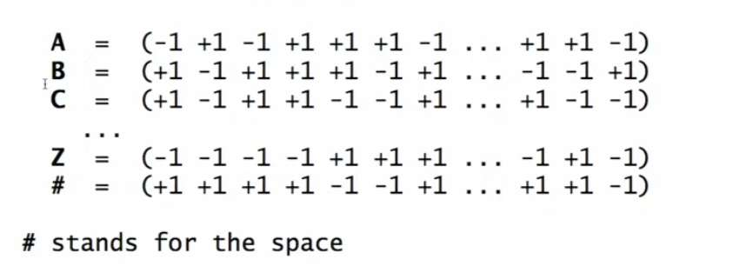
Example - Computing the Profiles
Step 1) Encoding the letters - Encode letters with 27 vectors
10k dim random vectors

Slide 22
Example - Computing the Profiles
Step 1) Encoding the letters - Encode letters with 27 vectors
10k dim random vectors
Step 2) Encode text as trigrams
Use permutation to have a sequence (rotate by right by 1): THE= rrT * rH * E
“The quick brown fox jumped over…”

Slide 23
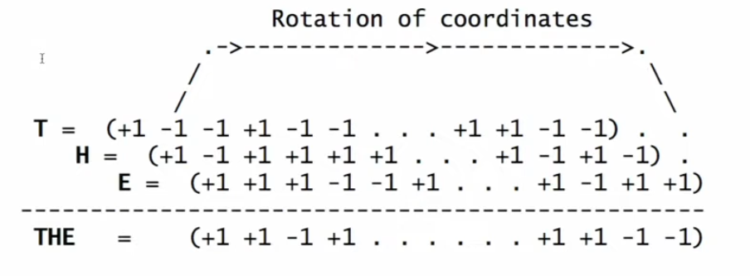
Example - Computing the Profiles
Step 1) Encoding the letters - Encode letters with 27 vectors
10k dim random vectors
Step 2) Encode text as trigrams
Use permutation to have a sequence (rotate by right by 1): THE= rrT * rH * E
“The quick brown fox jumped over…”

Slide 24
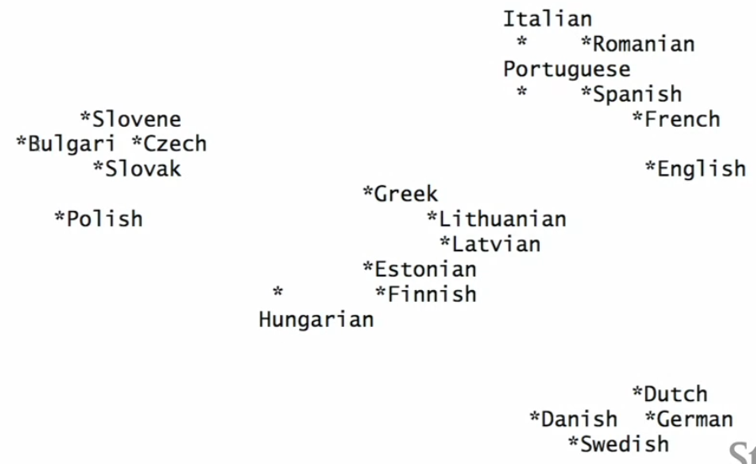
Example - Compare and Cluster
Step 3) Measure similarity: Cosine

Slide 25
Example - Computing the Profiles
Results:
97.3% accuracy
English profile: after ‘th’ the closest letter is “e”, then space, “a”, “i”, “r” and “o”
Q = rrT * rH
X = Q * Eng
Closest letter vectors: X ≈ E, #, A, I, R, O

Slide 26
Example - Computing the Profiles
Summary:
Start with random 10.000 dimensional bipolar vectors for each letter
Compute 10.000 dimensional vectors for trigrams with permute and multiply
Add all trigram vectors together to form a profile vector for languages and test sentences
Compare using cosine

Slide 27
Similarities to DL
Similarity:
Statistical learning from data
Data can be noisy
Both use high-dimensional vectors (NNs bog down when dim. Gets 10k?)
Differences:
Relies on mathematical theory, not on heuristics
New codewords are made from existing ones in a single application of HDV operations
Memory is a separate function (stores and retrieves data as nn search) Therefore:
- Transparent, Incremental, Scalable

Slide 28
Forecast
New computers will be built
Simpler, faster ML algorithms
Vision and Language
Multi-sensor integration & Robots

Slide 29
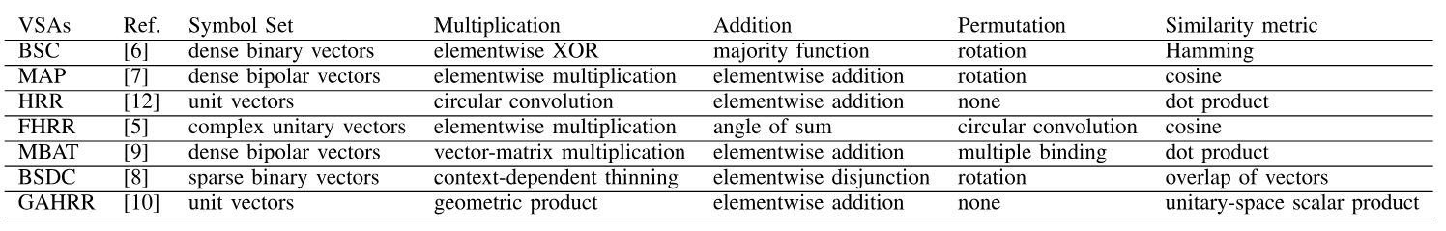
Forecast
Note! Different arithmetic is possible
New computers will be built
Simpler, faster ML algorithms
Vision and Language
Multi-sensor integration & Robots

Slide 30
Questions
Why Holographic?
Nature of the holograms is that it distributes the information
You can take any HDV in half, it’s going to contain the same information, but it’s going to be less precise
How is it not unsupervised learning:
No parameter optimisation
Why 10k?
10k allows you to build a system that can handle a network of 1b nodes.
What are the practical applications (besides recognizing languages)
Identifying EEG signals
When you go to high dimensional space, you can resolve things with linear classifiers.

